Slide 1
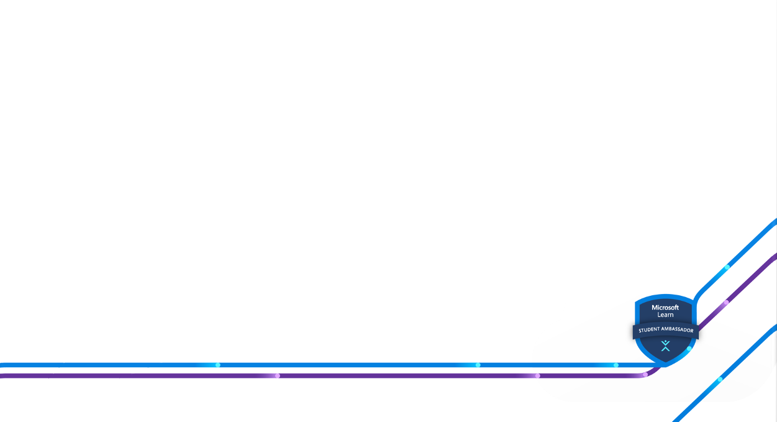
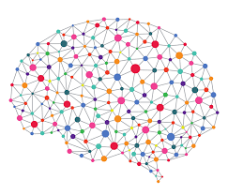
Intro to Neural Networks

Slide 2

Notes:
STC is a student community in VIT Vellore aimed at enhancing the skills of its members as well as fellow college students in various domains through quality projects and events tailored for skill development.

Slide 3


Apply at :
Microsoft Learn Student Ambassadors
Soorya Prakash | LinkedIn
Notes:
Connect with other students who share your passion in focused Leagues and use tech to solve real-world challenges together.

Slide 4
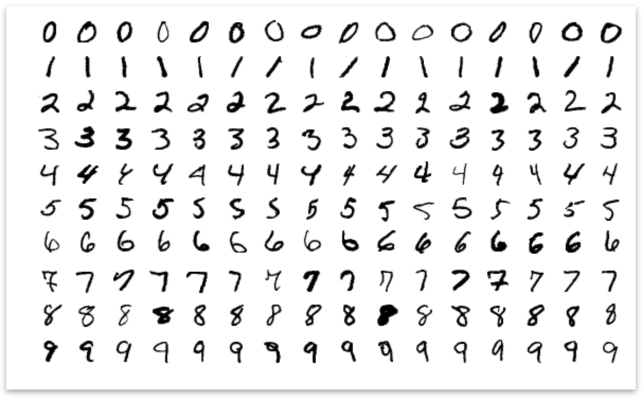
Notes:
Lets start this session with designing a program

Slide 5
Image of Number 4

Slide 6
What is Machine Learning?
Input
Input
Purpose Built Code
Output
Machine Learning Model
Program
Program
Output
Notes:
Usually in Traditional Programming ,We code a program solving a specific problem with a logic , we deliver input to it and get output .
Machine learning Is letting computers figure out how to map data with answers with experience rather than we hardcoding each and every cases
They make rules by themselves.

Slide 7
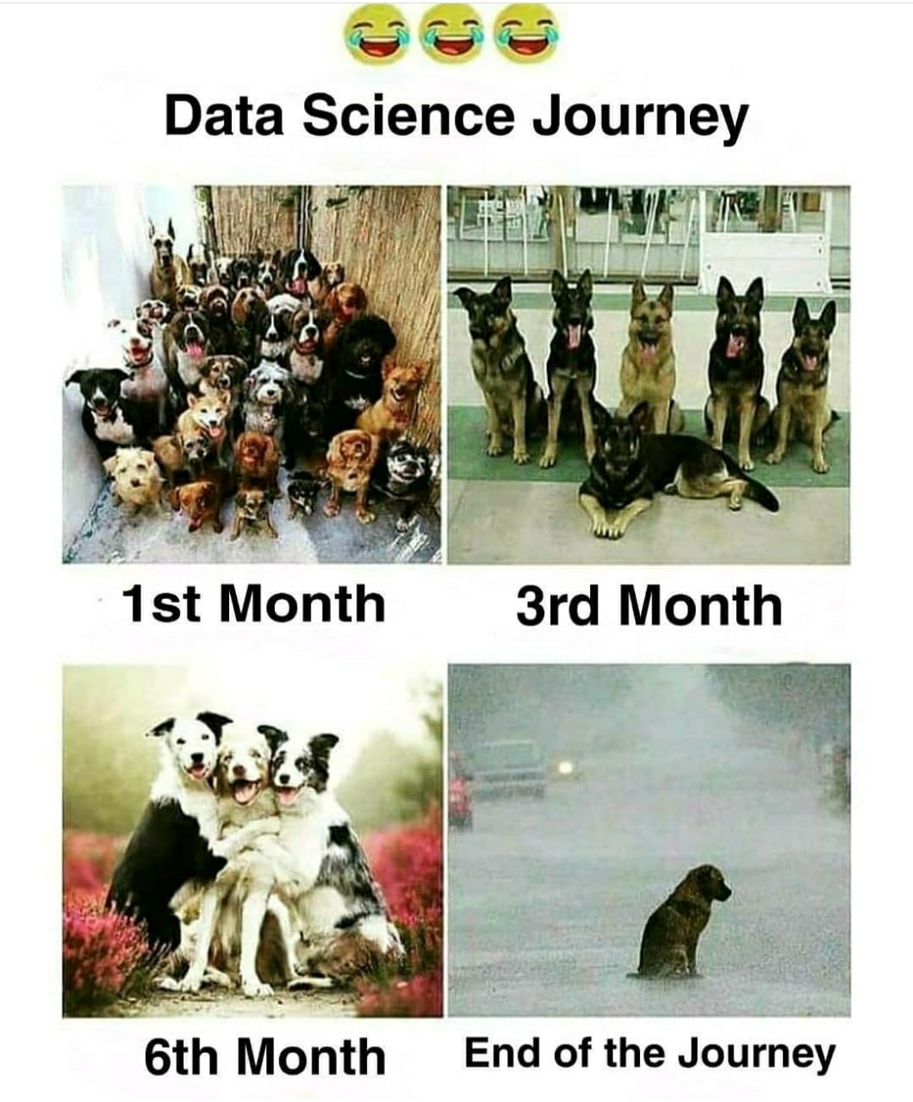
Data Science Journey

Slide 8
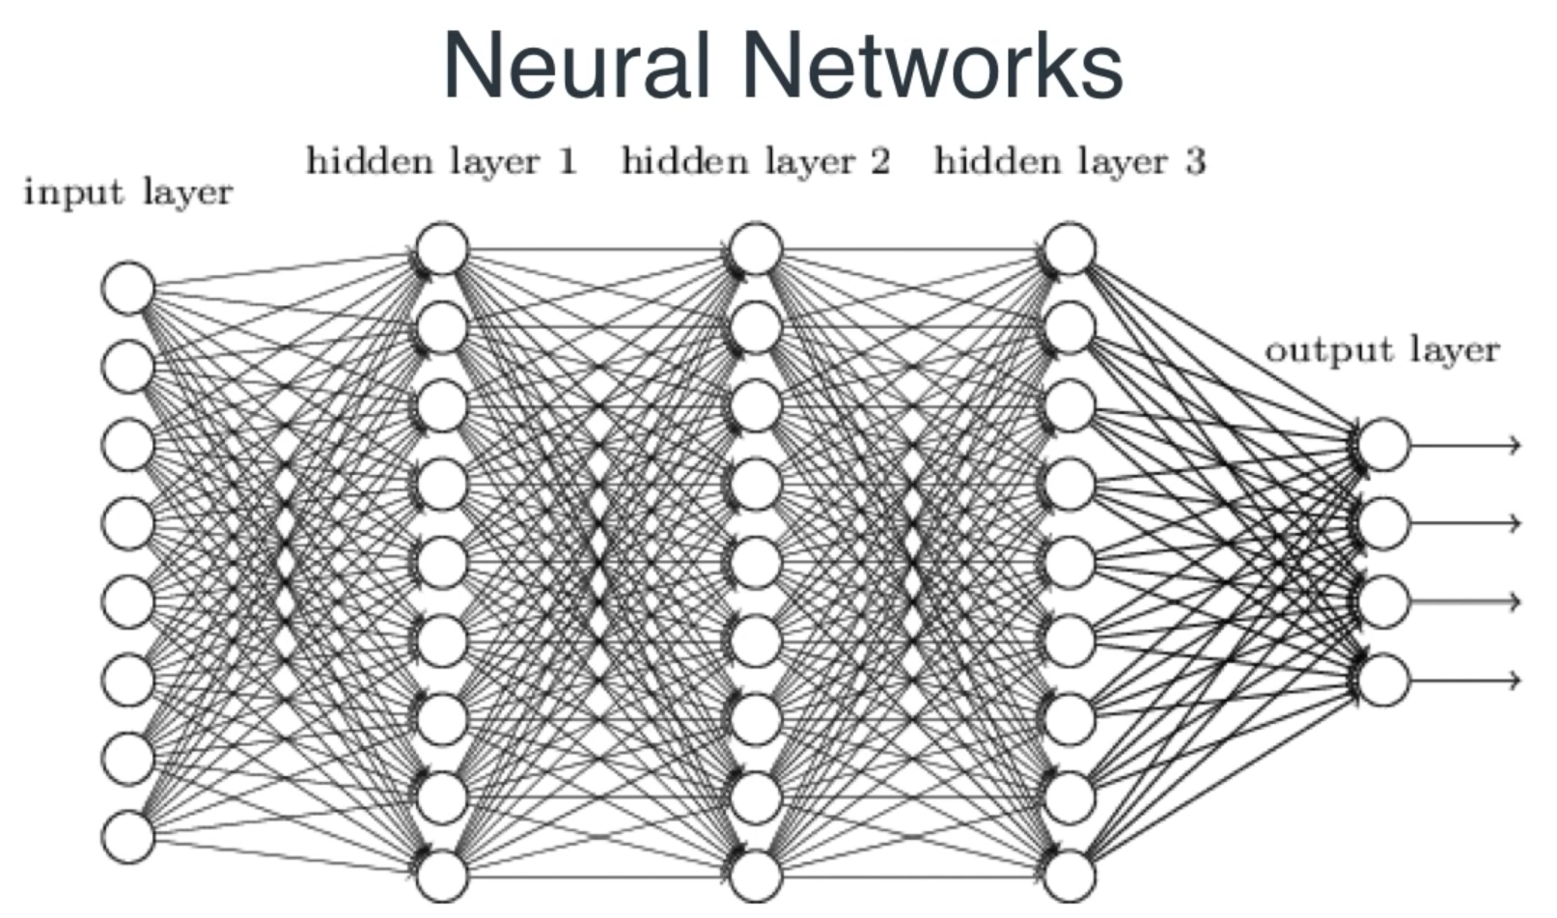

Slide 9
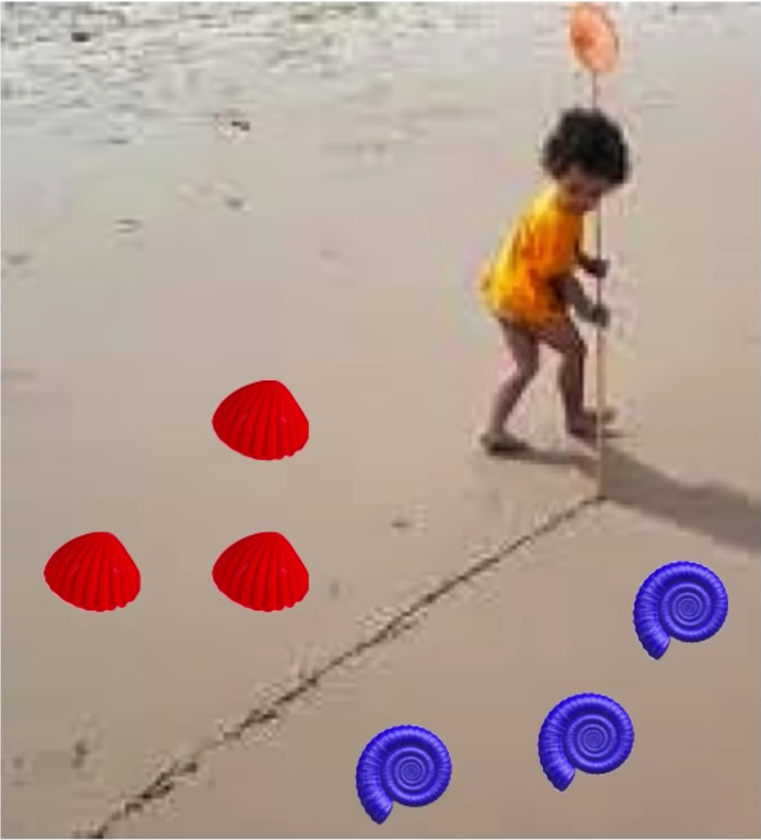
What Neural Networks actually does?

Slide 10
Linear Regression

Slide 11
You are a Real Estate Seller!
Area of the House(m^2) | Price of the House(in Lakhs)
5 | 50
50 | 100
100 | 75
150 | 50
200 | 110
250 | 162

Slide 12
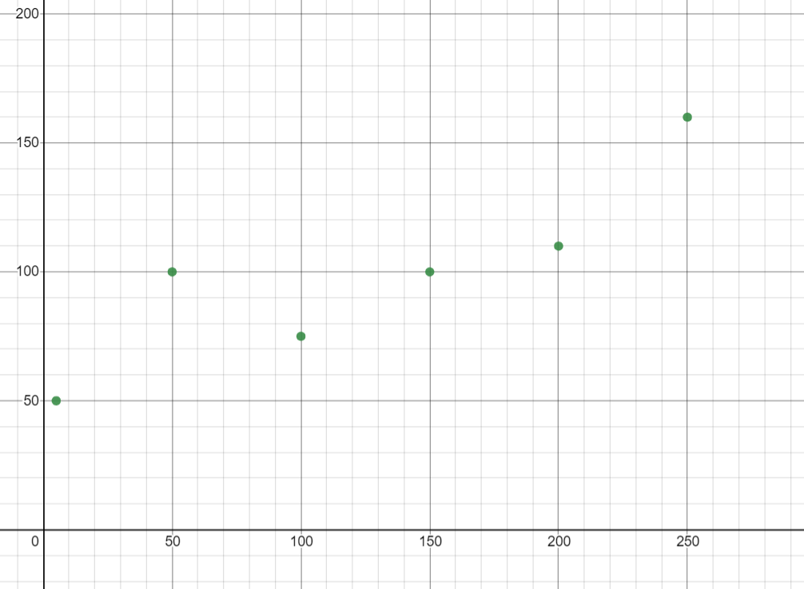
House Price (Y)
Area(m^2) (X)

Slide 13
House Price (Y)
Area(m^2) (X)

Slide 14
House Price (Y)
Area(m^2) (X)

Slide 15
Linear Regression
Linear regression is a method for finding the straight line that best fits a set of points.

Slide 16
House Price (Y)
Area(m^2) (X)

Slide 17
Loss
Loss is the penalty for a bad prediction. That is, loss is a number indicating how bad the model's prediction was on a single example. If the model's prediction is perfect, the loss is zero; otherwise, the loss is greater.
Notes:
The parameter which we took during plotting the line.We choose the distance between the line and point as something and we tried to reduce it.

Slide 18
High Loss
House Price (Y)
Area(m^2) (X)

Slide 19
High Loss
House Price (Y)
+
Loss =
+
+
+
+
Area(m^2) (X)

Slide 20
Low Loss
House Price (Y)
+
+
+
Loss =
+
+
Area(m^2) (X)

Slide 21
House Price (Y)
y=mx+c
House Price=m(Area)+c
Area(m^2) (X)

Slide 22
House Price (Y)
y=Wx+b
Area(m^2) (X)

Slide 23
What is Training a Model?
Training a model is an art of finding the best values to multiply with the input to get an answer.
Notes:
How do you find the best line ? Brute Force or Systematic Approach.
What if there is an guide which can show us the direction in which we can take new value of slope so that it will have less loss than the loss of the slope which we took before.
One way which can show us the direction is derivate.

Slide 24
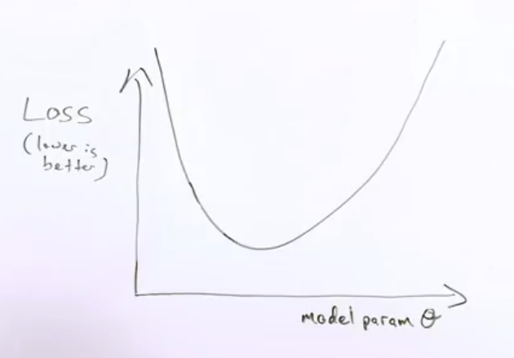
Gradient Descent
W
Notes:
Derivative of the loss function with respect to the gradient.

Slide 25
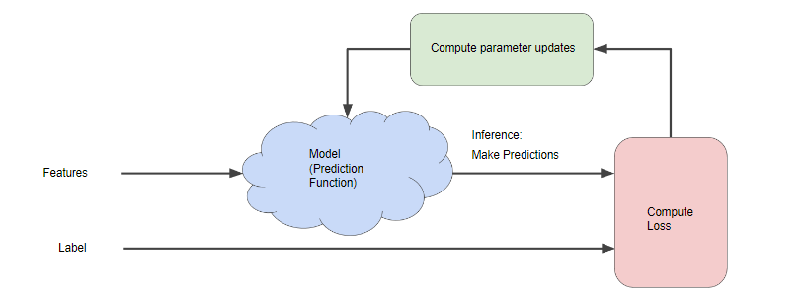
Approach to Find the Best Parameters :

Slide 26
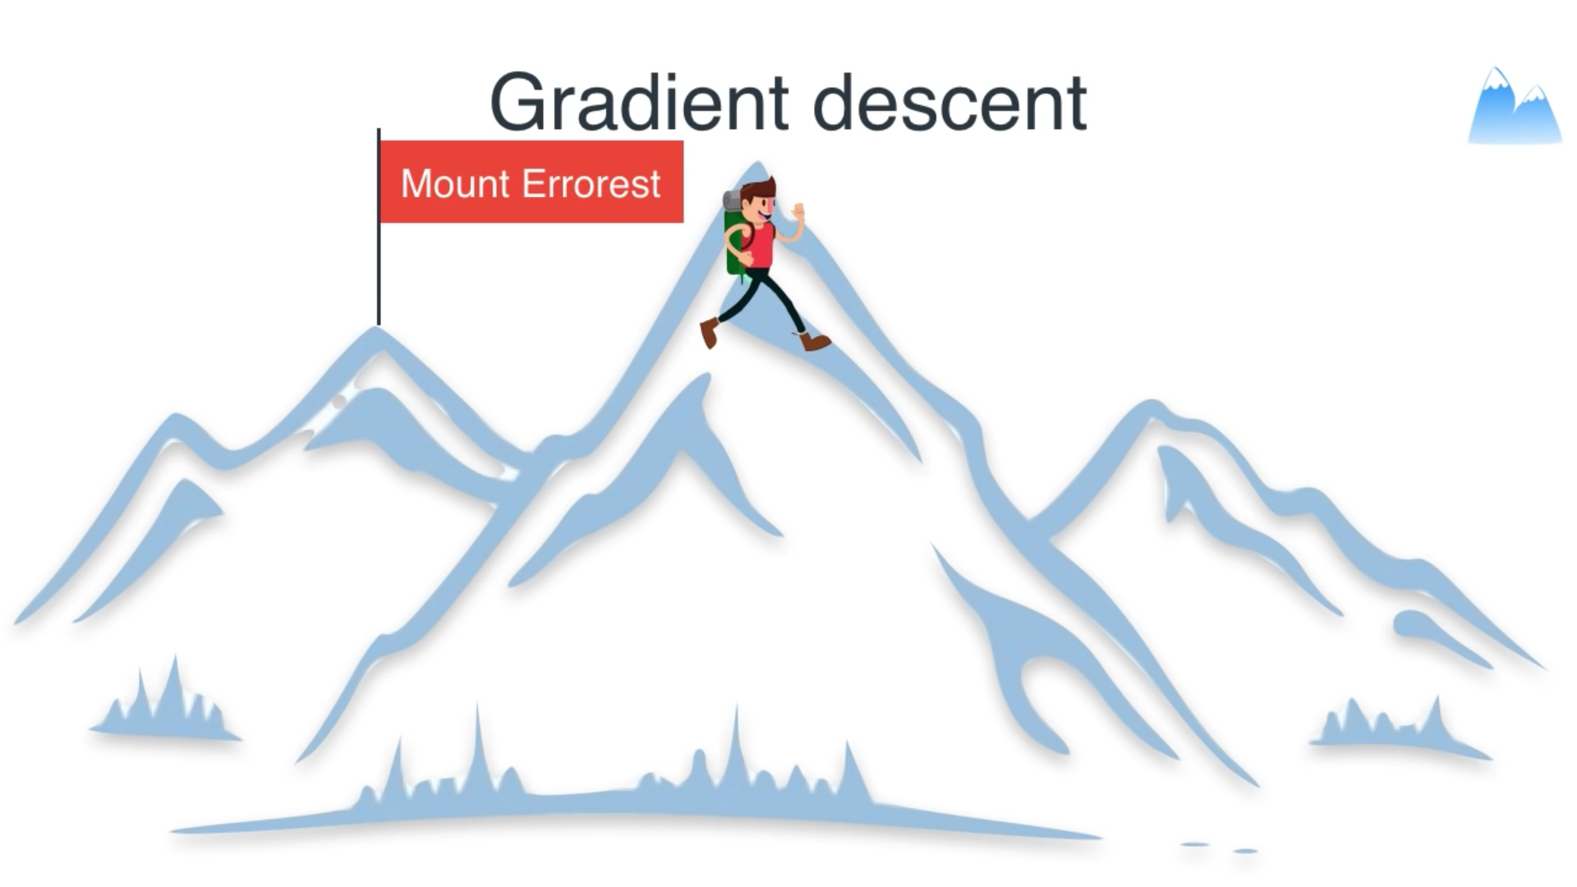
Notes:
Limited space around you.

Slide 27
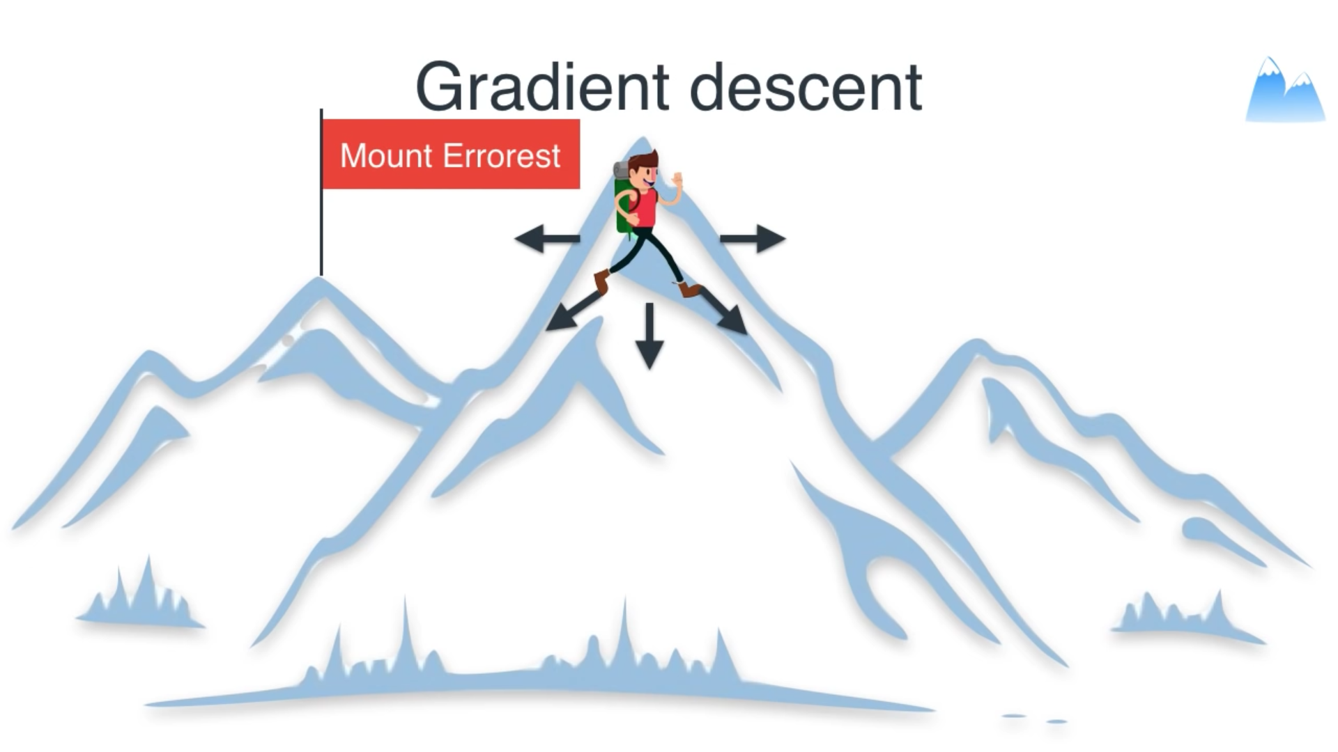

Slide 28


Slide 29
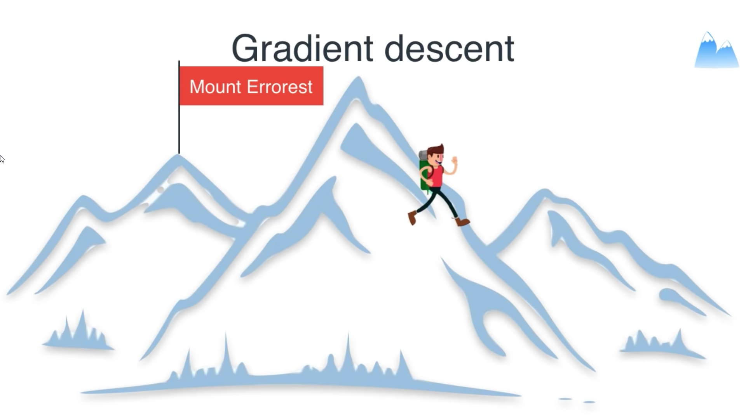

Slide 30
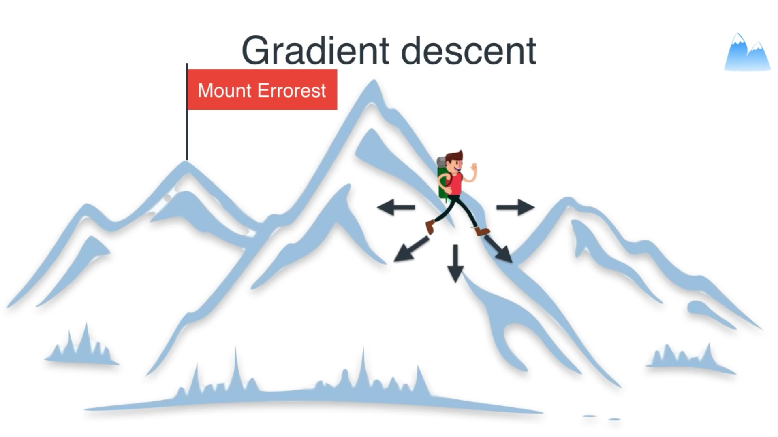

Slide 31
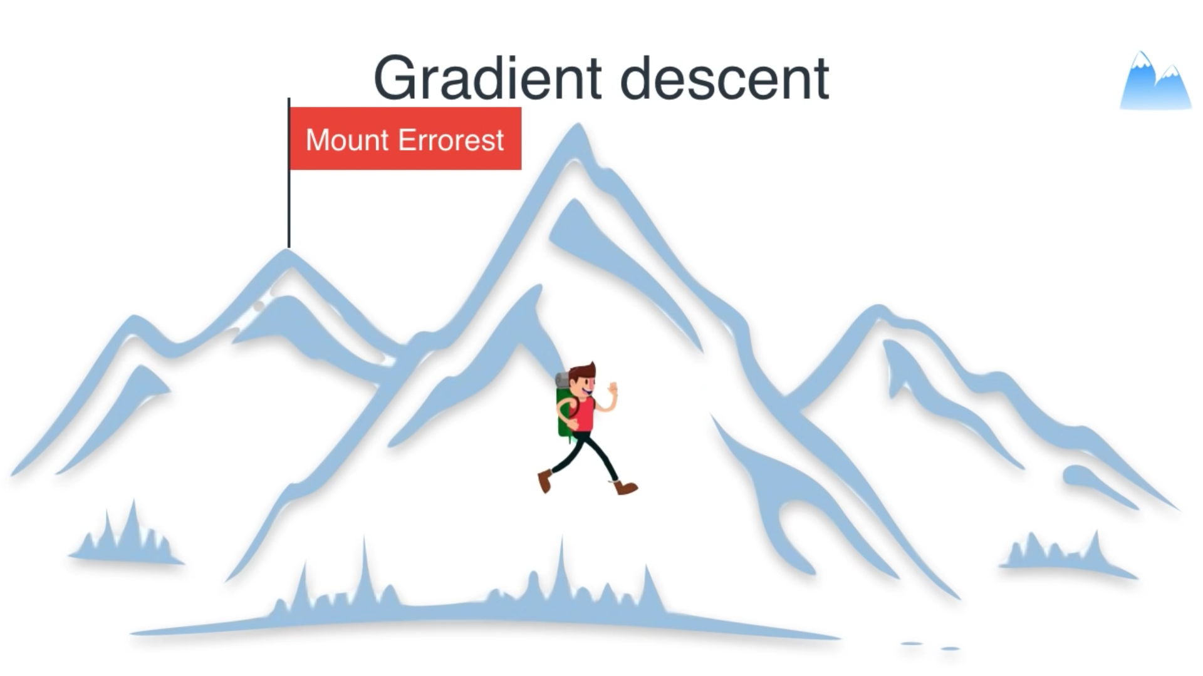

Slide 32
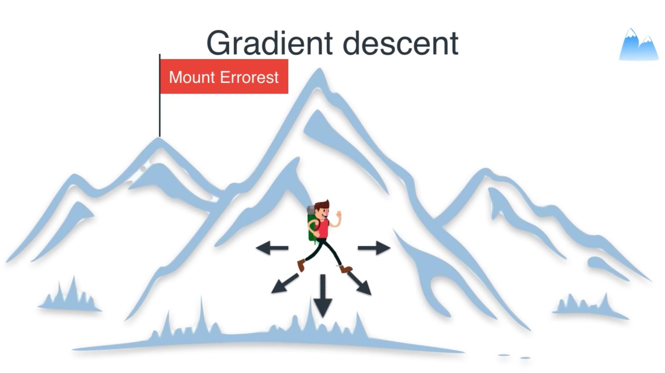

Slide 33
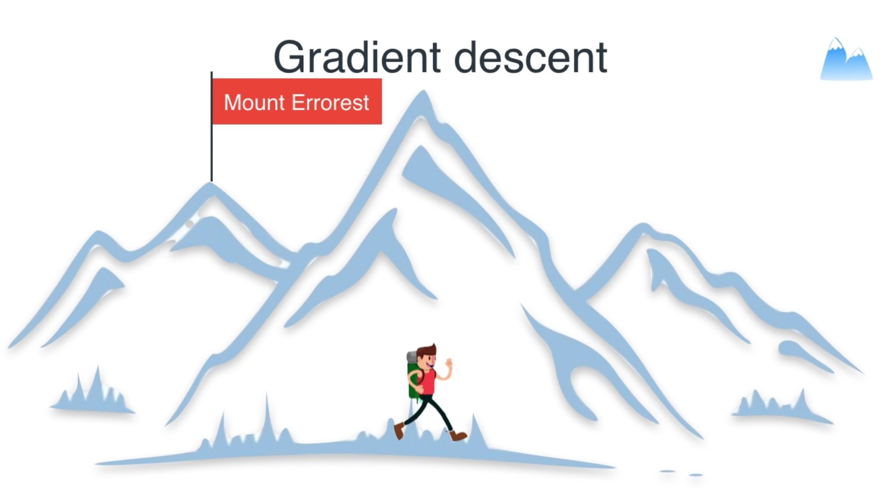

Slide 34
Linear Regression with 2 Inputs
Area
w2
w1
Area
Price
Price
w1
Age of the house
Price = w1(Area) +b
Price = w1(Area)+w2(Age of the house) +b
y=w1x1 +b
y=w1x1 +w2x2 +b

Slide 35
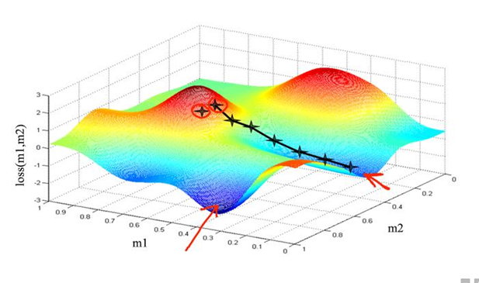
Gradient Descent in 3D
W2
W1

Slide 36
Logistic Regression
Notes:
Well we have dicussed some important concepts.

Slide 37
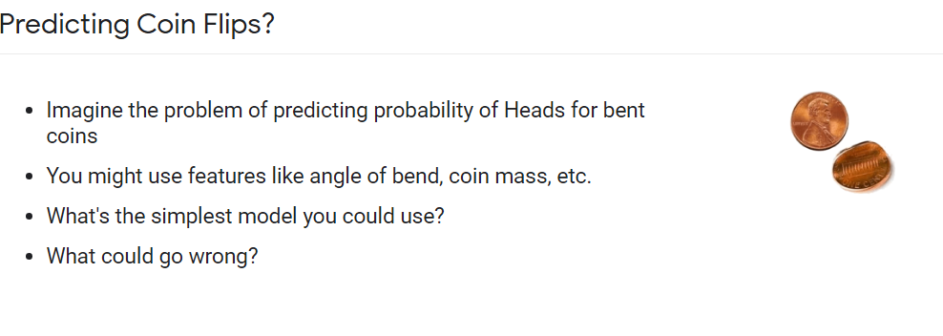

Slide 38
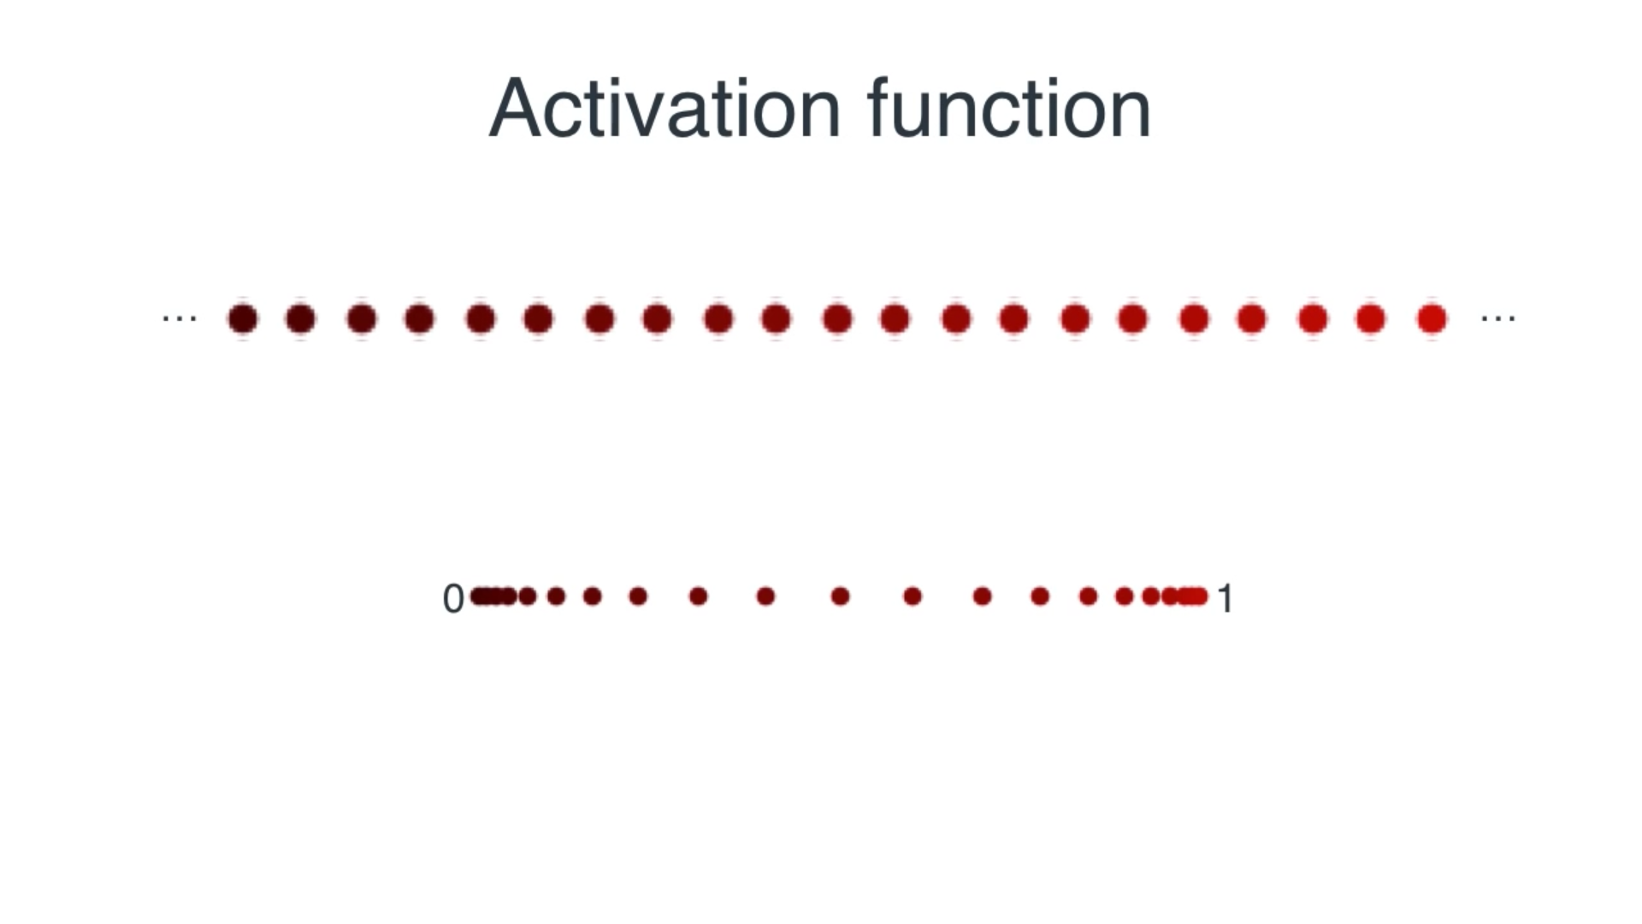
Need for Activation Function
Notes:
Bounding values between 0 to 1

Slide 39
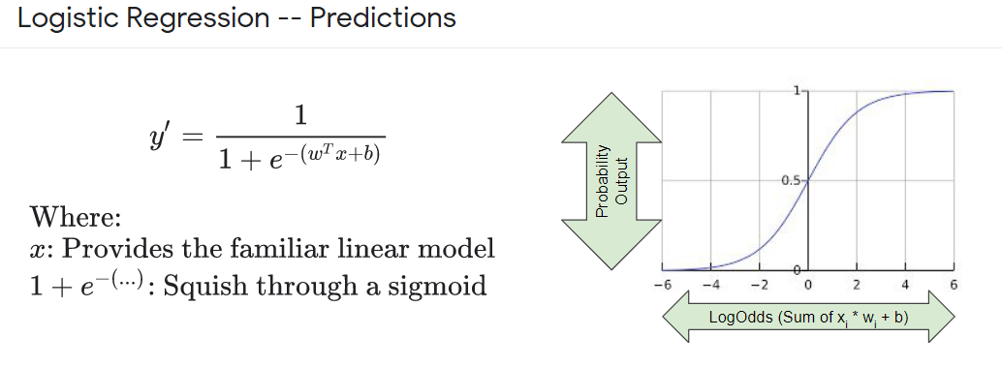
Fitting Values Between 0 and 1:

Slide 40
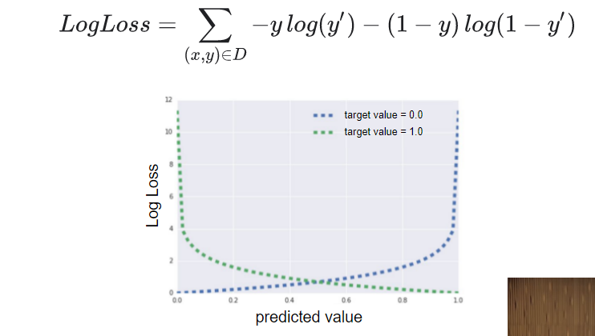
Loss Function:

Slide 41
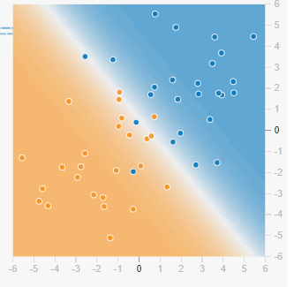
Logistic Regression in Nutshell

Slide 42
Why Deep Learning?
Notes:
Unstructred data like image,text ,audio

Slide 43
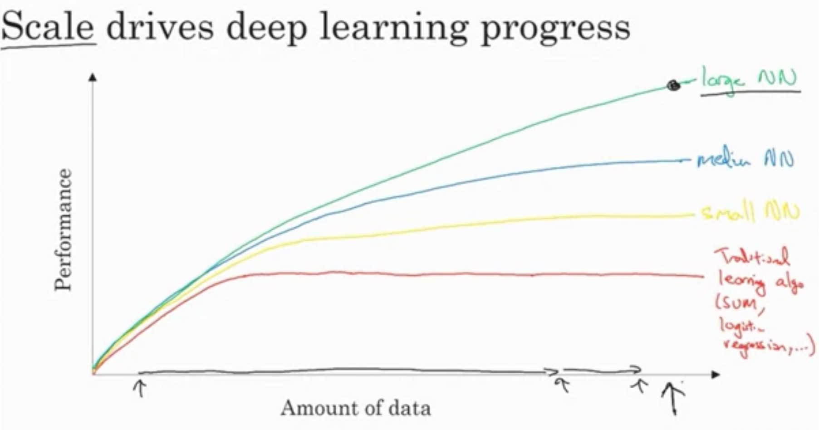
Notes:
Understanding patterns

Slide 44
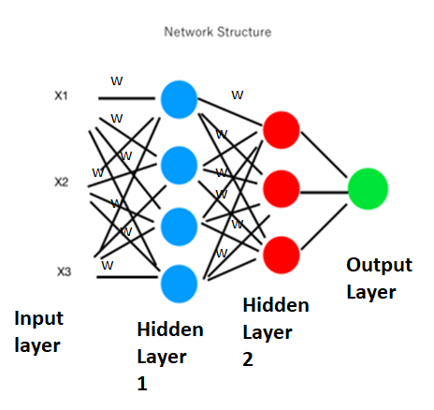
Neural Network Structure:
Area
w1
w2
Price
Age of the house
w3
Bedrooms
Notes:
NN Structure

Slide 45
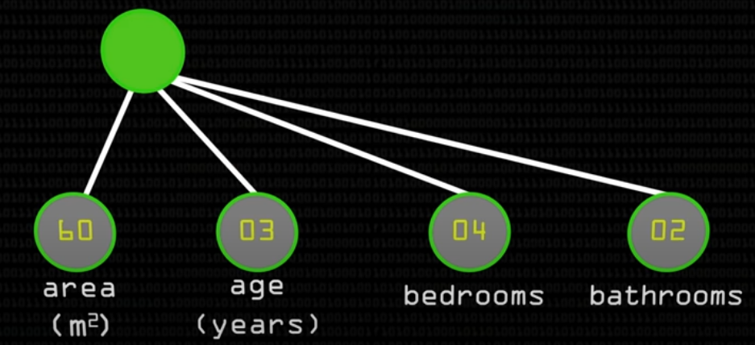
Z=W₁X₁+W₂X₂+W₃X₃+W₄X₄
W ₁
W ₂
W ₃
W ₄
Notes:
Problem of linearity.

Slide 46
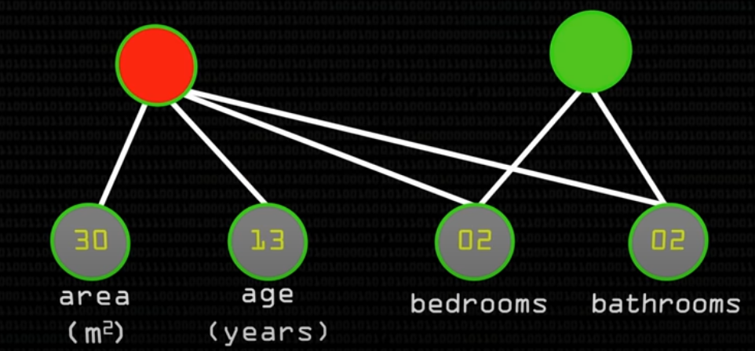
Price

Slide 47
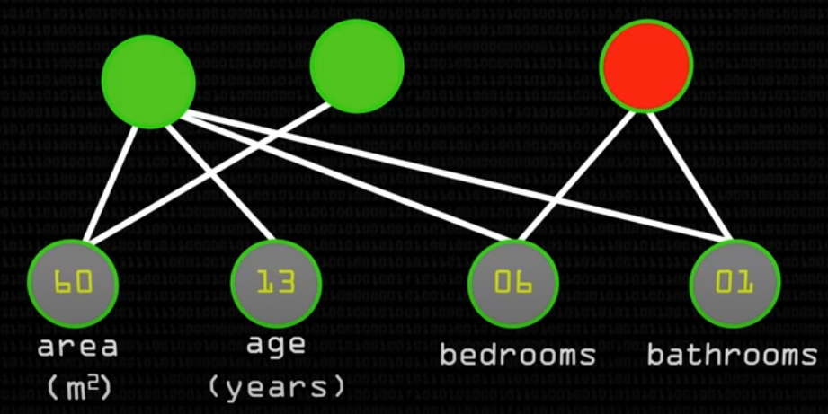
The Curious Case of 6 Bedrooms and 1 Bathrooms
Area Matters
I Look For Bathrooms/Bedrooms

Slide 48
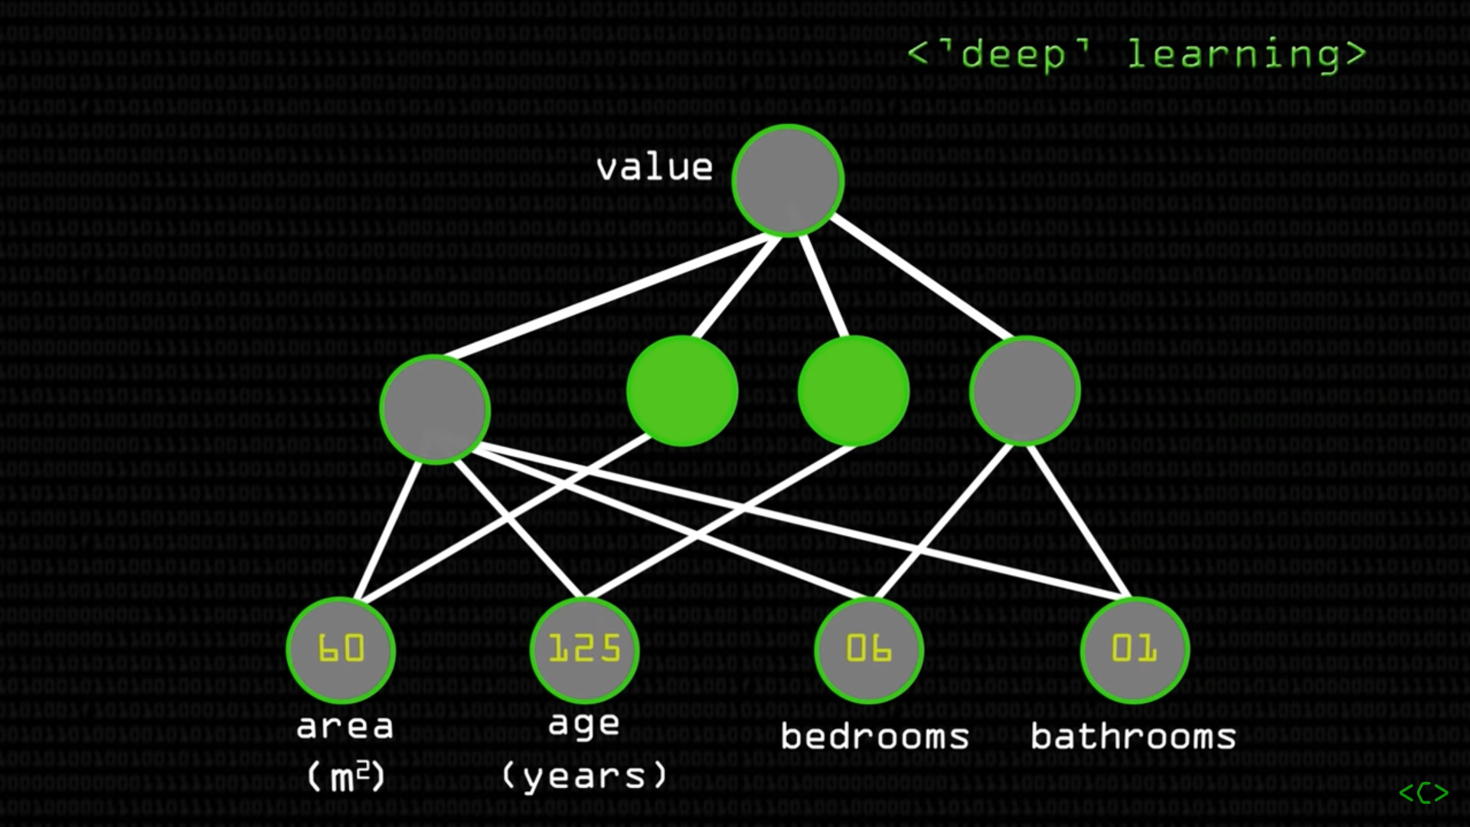

Slide 49
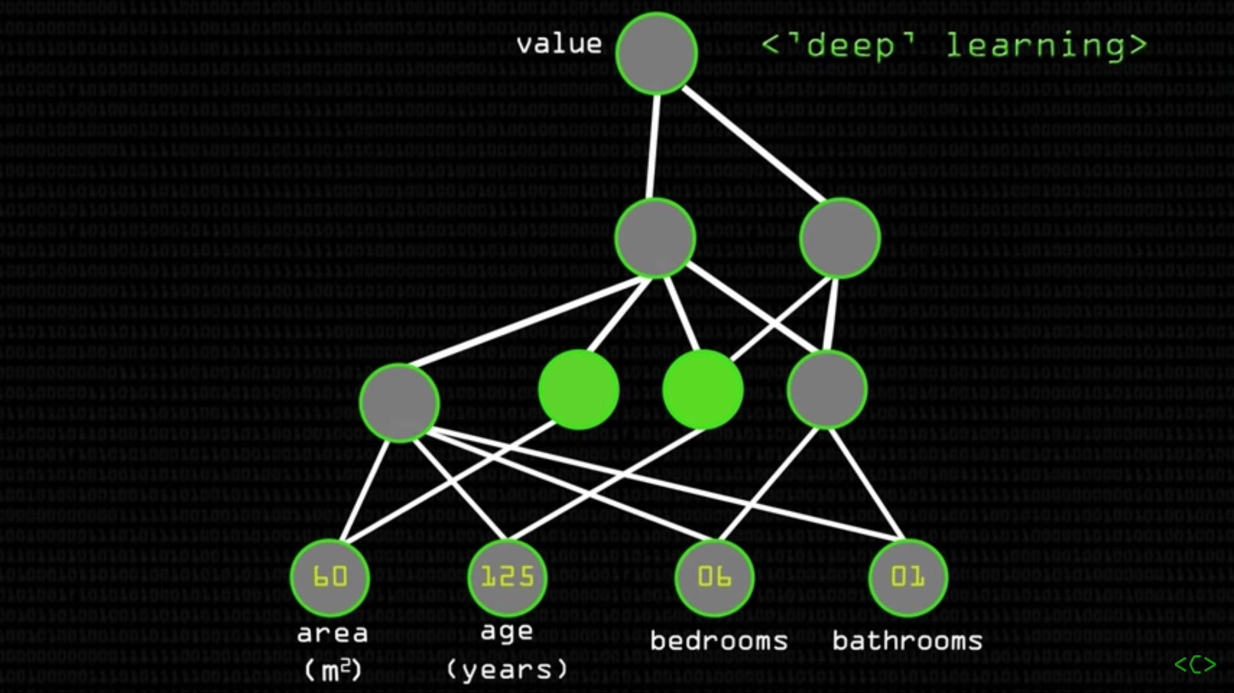

Slide 50
Handwritten Digit Classification

Slide 51
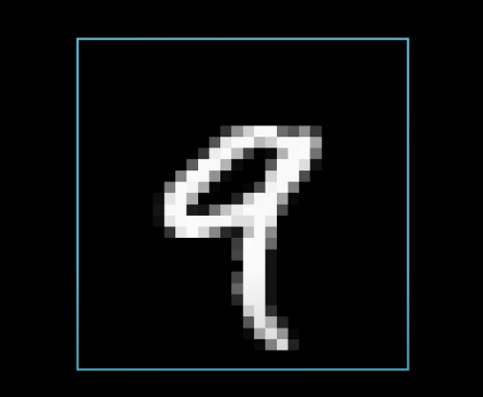
Image of Number 9

Slide 52
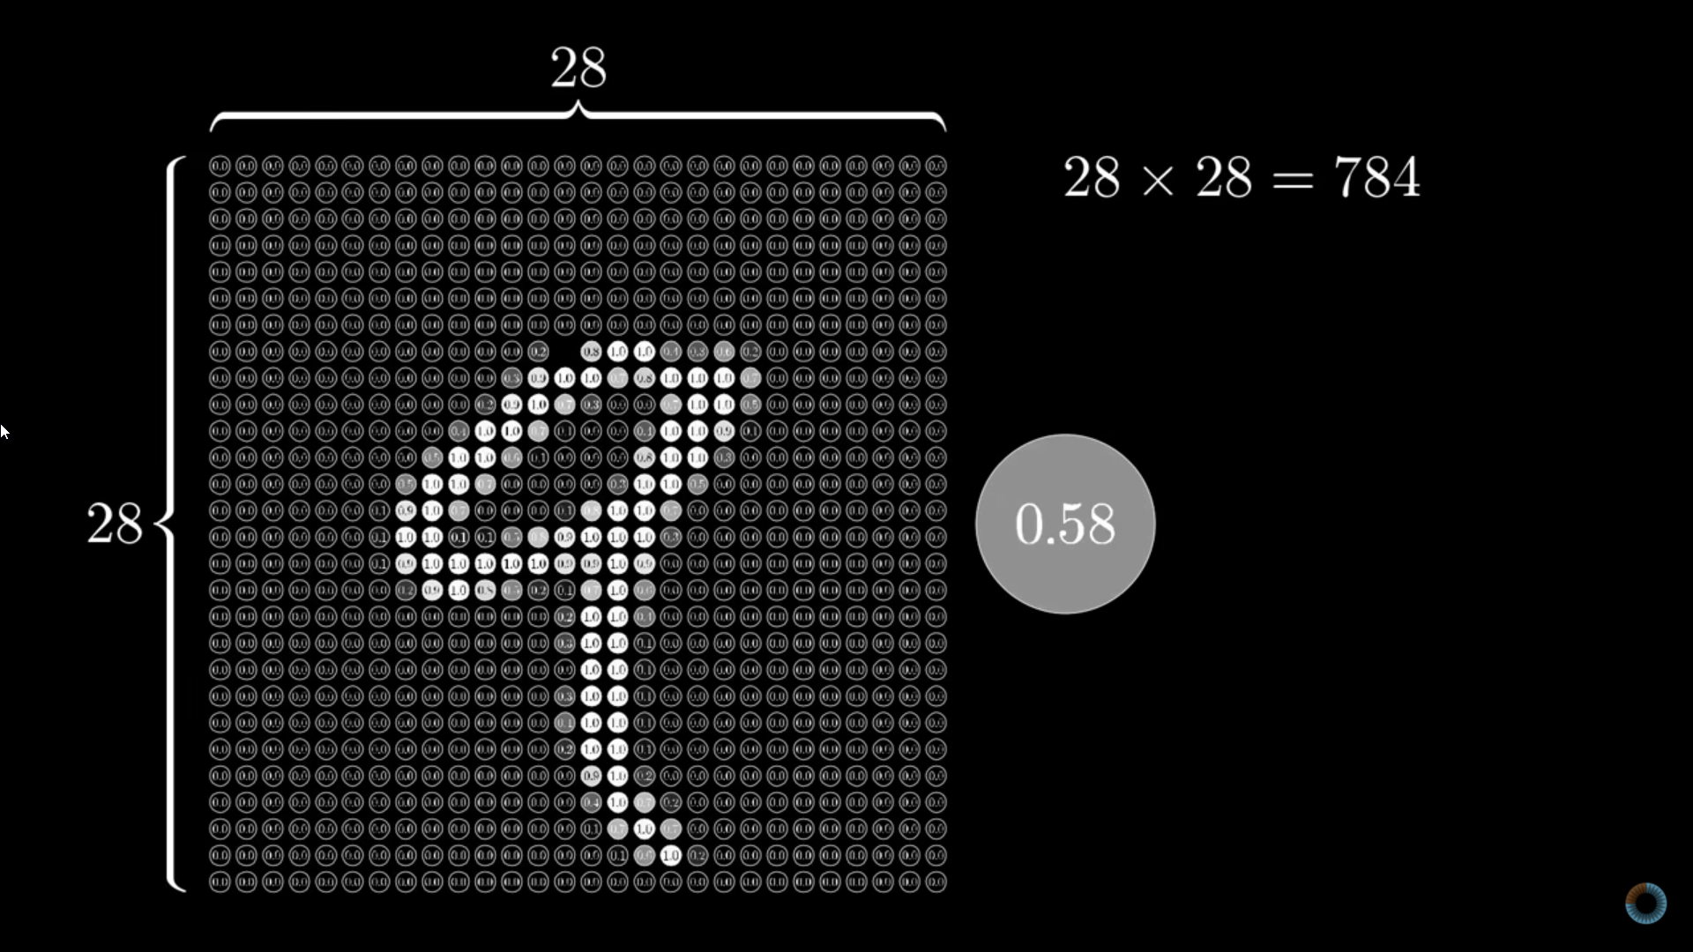
How Image is represented in Computer?
Notes:
Image consists of pixels with values of grayscale intensity values.

Slide 53
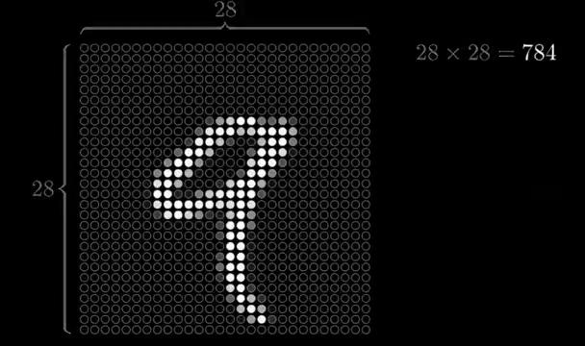
Notes:
We convert the 28*28 matrix into unidimensional matrix.

Slide 54
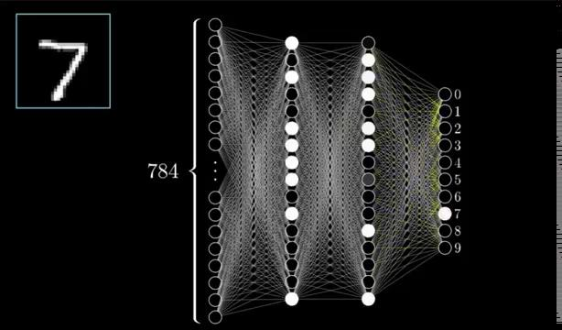

Slide 55
MNIST Digit Classification.ipynb - Colaboratory (google.com)
Notes:
You don't have to understand each and every line of code in the notebook. You will learn them gradually .But once you get an Idea of how neural network works ,learning them becomes simple.

Slide 56
Explore More on :
But what is a Neural Network? | Deep learning - YouTube
Deep Learning | Coursera
Intro to optimization in deep learning: Gradient Descent (paperspace.com)
Kaggle: Your Home for Data Science
Foundations of data science - Learn | Microsoft Docs

